Slide 1
Constraint Satisfaction Problem
UI 4
Markošová

Slide 2
Summary of the last lecture
Properties of heuristic functions.
Looking for a good heuristics (relaxation, subproblem solution).
Local search, properties.
Local search: hill climbing, genetic algorithm
Simulated annealing –not finished

Slide 3
Outline
Simulated annealing.
CSP problems: definition, examples
Node and edge consistency, binarization of constraits.
Backtracking for CSP.
Heuristics for CSP.

Slide 4


Simulated annealing
Idea: The worse state is allowed during the solution of the problem, but only with certain probability.

Slide 5
A bit of physics
How to put sugar cubes into a box? Try this method
1. Pour cubes into a box. They take random positions.
2. Than shake the box, until we get the configuration of the sugar cubes
positions having the minimal potential energy.
What box shaking means?
If we want to get an appropriate cube positions with a low potential energy, we shake, that means we create transient position configuration, which might have even greater or high potential energy.
This is the principle of the simulated annealing.

Slide 6
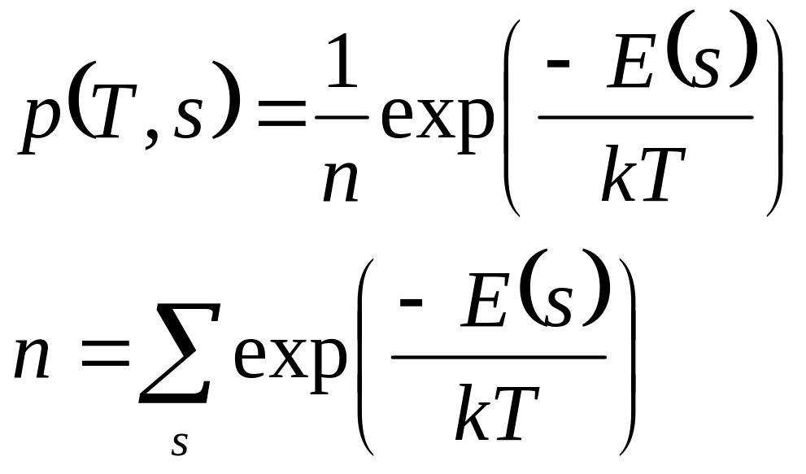
Distribution of configurations of the set of distinguishable particles at the temperature T is given as:
E – free energy
T – temperatura
k- Boltzman constant

Slide 7
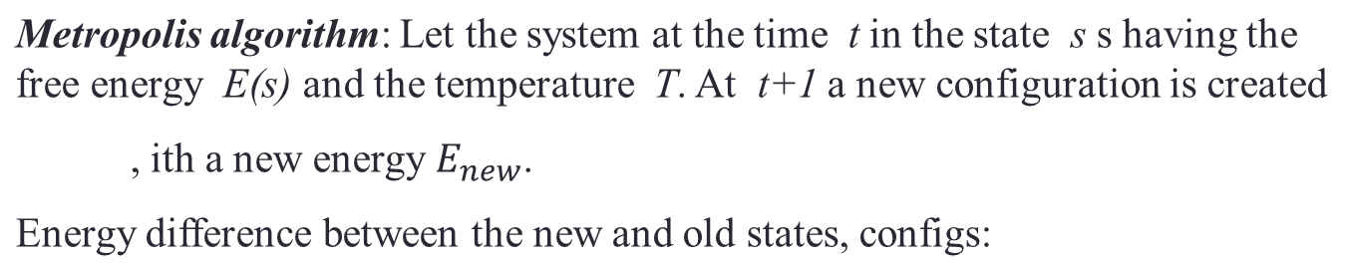

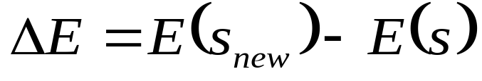


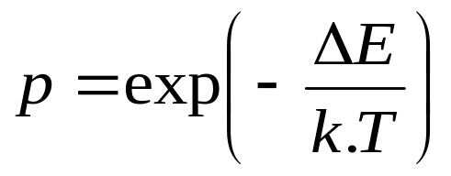
If accept the new configuration with the probability 1.
If accept the new configuration with the probability p

Slide 8
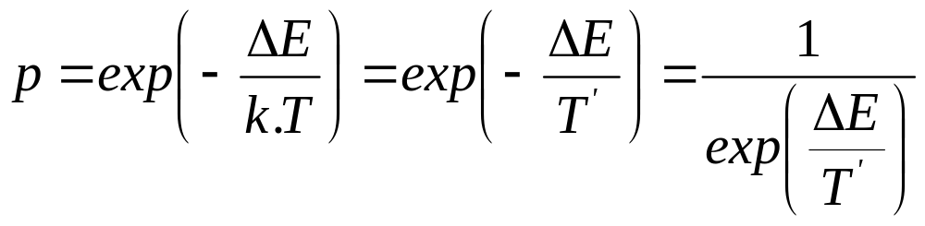
What is „energy“ in the simulated annealing?
It is a function in which we want to find a minimum (sum of the blackberries potential energies, path between the towns in the traveling salesman problem, evaluation function in the n-queen problem etc.)
.
What is „temperature“ in the simulated annealing?
It is a constant governing the acceptance of a “worse” configuration, state.

Slide 9
Example – traveling salesman problem.
1
1
6
2
6
2
5
3
5
3
4
4
s=(1,2,5,4,3,6,1)
Initial configuration
Perturbed initial configuration
f(s) – function we want to minimize, distance between the towns

Slide 10
Create town ordering (configuration)
Calculate the path length for this configuration. This is „energy“ – function, we want to find a minimum of.
Disturb initial configuration; if the path among the towns is then longer, regulate the temperature so, that the probability of acceptance of this worse stat is close to one.
Repeat m times at this temperature.
Lower the temperature and thus the acceptance probability of a longer path config and repeat the process at this new temperature.

Slide 11
Algorithm
Algorithm SIMULATED-ANNEALING
Begin
temp = INIT-TEMP; put an initial temperature
konfig = INIT-konfig; initial configuration
while (temp > FINAL-TEMP) do
while (inner_loop_criterion = FALSE) do
new_konfig = PERTURB(konfig);
ΔE = E(new_konfig) -E(konfig);
if (ΔE < 0) then
konfig = new_konfig;
else if (RANDOM(0,1) > e^{-(ΔE/temp)}) then
konfig = new_konfig;
temp = SCHEDULE(temp);
End.

Slide 12
Simulated annealing search properties
It is possible to prove mathematically , that if the temperature T decreases infinitely slowly, then the simulated annealing finds global optimum with the probability close to one .
Simulated annealing is used in layout problems, planning problems etc.

Slide 13
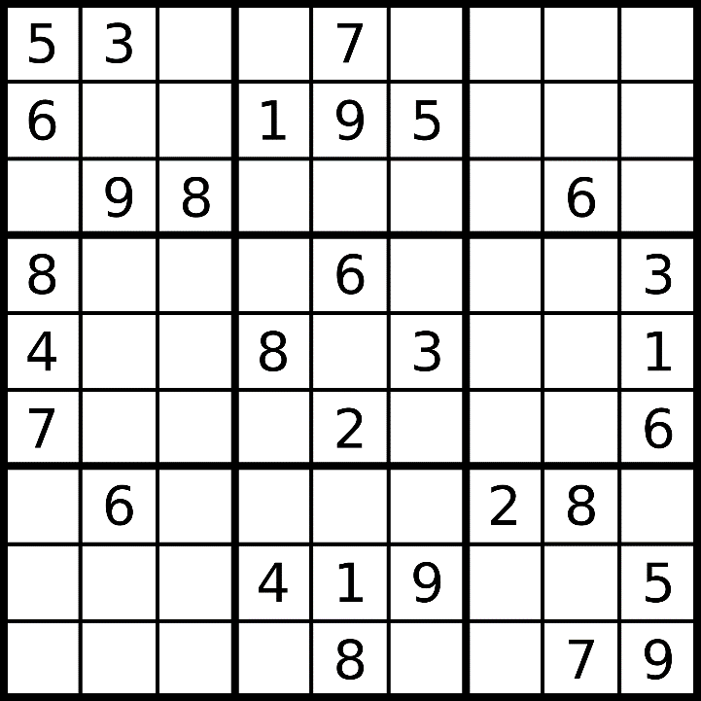
CSP Example
CSP problem
Sudoku game:
Fill all the squares in a correct way, respecting several constraints.
Constraints: On each square there is one number 1, 2….9. There are different numbers in all squares of each row, each columns and in each bigger square.

Slide 14
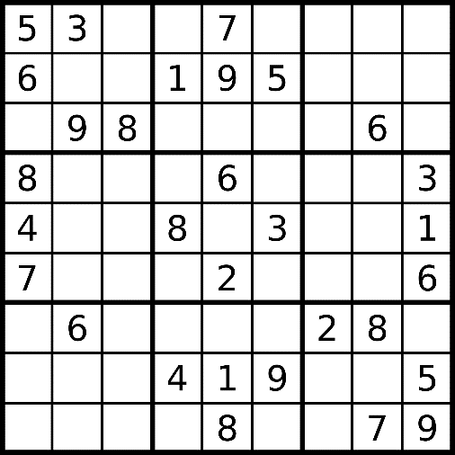
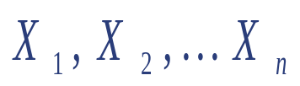
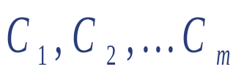

CSP definition:
Set of n variables (small squares in Sudoku)
Set of constraints
Each variable has a nonempty set of its possible values (set {0,1,2…,9}in Sudoku)
State : defined by assigning a value to the variable.
Consistent state: assignment which does not violate the constraints
Complete state: state where all variables has values assigned
Solution of CSP: complete and consistent state

Slide 15
Another example
Variables: x, y, z
Domains: Each variable can have a value from this set {1,2,3,4,5,6}
Constraints: x + y =6, y. z is less or equal 20
Solutions: x=1, y=5, z=4
x=1, y=5, z=5
x=1, y=5, z=6
x=2, y=4, z=5
x=2, y=4, z=6
Consistent and complete value assignment

Slide 16

Example: Map-Coloring (Russel, Norwig)
Variables WA, NT, Q, NSW, V, SA, T
Domains D_{i} = {red, green, blue}
Constraints: neigbor regions have different colours
e.g., WA ≠ NT, or (WA,NT) v {(red,green),(red,blue),(green,red), (green,blue),(blue,red),(blue,green)}

Slide 17

Example: Map-Coloring
How many solutions we have for this problem?
For each coloring of WA and Q we have two possibilities to color other regions. There are 6 possibilities.
Solutions are complete and consistent assignments,
e.g., WA = red, NT = green,Q = red, NSW = green,V = red, SA = blue,T = green

Slide 18


Example:
Problem of 8 queens as CSP:
Variables: position on the rows
Domains: each variable has a domain {1,2,3,4,5,6,7,8}
CSP with final discrete domain
Constraints: queens cannot attack each other

Slide 19

Constraint graph (graph vizualizing constraints)
Binary CSP : each constrain is a relation of two variables. Constraint graph: nodes are variables, edges are constraints.

Slide 20
Variants of CSP problems
Problem in discrete variables
  With finite domains
    n variables, number of complete assigments d → O(d ^{n})
  With infinite domains:
    integers, strings, etc.
Problem in finite continuous variables
  e.g., start/end times of observations in experiment
  linear constraints are solvable in the polynomial time with a help of the linear programming

Slide 21
Variants of constraints
Unary constraint only one variable is affected,
  E.g., SA ≠ green
Binary constraints pair of variables is affected,
  napr., SA ≠ WA (the colour of neighbor regions is different)
Higher-order or n –ary constraint more variables are involved
  cryptarithmetic constraint

Slide 22



Cryptoaritmetic problem:
Replacing letters by the numbers gives a correct result.
T W O
+ T W O
______________
F O U R
Domains?
Numbers 0 - 9
Constraints?
Each number has different value.
...
Solution?
E.g.. O=5, R=0, T=7, W=6, U=3, F=1

Slide 23
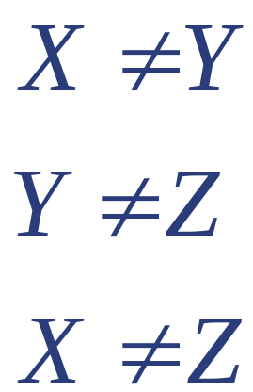



Binarization
Problem of the
constraint binarization
CSP algorithm: Work with unary or binary constraints
Binary CSP: can be visualized as a constraint graph
Example:
Constraint systém: Constraint graph
X
Y
Z
Good news: each CSP can be turned to a binary CSP.

Slide 24
Node and arc consistency
Knowing the consistency techniques, it is possible to reduce the problem complexity
Node consistency
In the constraint graph the node represents certain variable.
Definition of the node consistency:
Node is node consistent if for each value x in the domain of the variable, unary constraints are fullfilled. .
How to reach the node consistency:
Simply remove those values from the domain which causes the problem.

Slide 25
Example:
Variables : X, Y
Domain for X: {0,10} Domain for Y: {5, 20} integers
Constraints: binary constraint Y > X, unary constrait X>5
Node consistent variant of the problem
Variables : X, Y
Domain for X: {10}, Domain for Y: (5, 20)
Constraint: binary constraint Y > X.

Slide 26



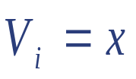
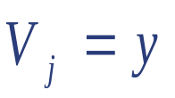
Arc consistency:
Binary constraints are represented by the arcs of the constraint graph.
Definition of the arc consistency:
Arc is arc consistent if for each value x from the domain of variable there exists some value y from the domain of such that and is allowed by the binary constraint.
How to reach arc consistency:
Remove such values from the domain of to which there is no corresponding value in the domain of .

Slide 27
Example:
From the domain of NT remove red and from the domain of SA remove red and blue.

Slide 28



Question: Is it possible, that the problem is arc consistent, and in spite of this CSP has no solution?
Example:
X
Z
Y

Slide 29


Question: Is it possible, that the problem is arc consistent, and in spite of this CSP has no solution?
Example:

Slide 30
Algorithms of the systematic searching
Generate and test algoritmus (GT)
Generate systematically possible assigments to the variables and the complete assigment is tested whether the constraints are fullfiled . Solution is the first appropriate combination.
Algorithm is: -complete
- unoptimal
- exponential time and space complexity

Slide 31
CSP as a searching problem
Initial state: empty assignment, no variable has a value
Successor function : operators assigning values, avoiding
conflicts with those previously assigned
Goal test: positive for complete and consistent assignment
Step cost: for example constant for each step

Slide 32
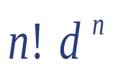

CSP as a searching problem for the state colouring
CSP can be formulated as a searching problem (n – number of variables (states) , d – number of values (colours)).
Bred first search: 1. level branching - nd
2. level branching- (n-1)d
.
.
.
n. level - leaves
There are only : complete configurations

Slide 33

Example Sudoku:
1
2
…
…
1
2
…
…

Slide 34
Backtracking search
Backtracking is in fact depth first search, which in each step assignes the value to only one variable. Algorithm back tracks when there is no variable to assign.

Slide 35

Backtracking example

Slide 36

Backtracking example

Slide 37

Backtracking example

Slide 38

Backtracking example

Slide 39
Backtracking search
Assignment of the variables is commutative, e.g.,
[ WA = red then NT = green ] is the same as [ NT = green then WA = red ]
In each step only one variable is assigned.
Backtracking search is the basic algorithm for the CSP problem
Can solve n-queens for n ≈ 25

Slide 40
Backtracking, map colouring example
First the map of Australia is empty. Variables are ordered in a que.
Assign all possible values to the first variable in a que, for example WA teritory.
Take the first unexpanded node as in the depth first and assign all rest colours to the second variable in a que, for example NT.
Repeat 3 until we get a correct assignment or the constraint violation.
If the partial solution violates some constrain, BT algorithm back tracks to the last assigned value, which has an alternative.

Slide 41
More intelligent backtracking:
Let the ordering of the variables in the simple backtracking is: Q, NSW, V, T, SA, WA, NT

Slide 42
Q, NSW, V, T, SA, WA, NT
The next one, after T, is SA, and cannot fulfill the constraint, but backtracking returns to the deepest node which has an alternative what is T. This is nonsense.

Slide 43
Q, NSW, V, T, SA, WA, NT
conflict set
Inteligent backtracking (called backjumping) returns here.

Slide 44
Conflict set :
Conflict set for the X variable is a set of values assigned before, which are connected with X by constraint.
Simple backtracking and its improvements :
Possibilities of the improvement:
Effectivity can be improved by the aprropriate ordering of the variables and appropriate ordering of the value assignemnt
Is it possible to estimate the possible conflict set?

Slide 45
Heuristics for the CSP
Heuristics in CSP concerns state, not the path to the goal and help us to find the violation of the constraints as soon as possible
Most constraint variable, or minimum remaining value (MRV) heuristics.
Most constraining variable, or the degree heuristika.
Least constraining value heuristics.

Slide 46

Minimum remaining value (most constrained variable)
Minimum remaining value
  Choose a variable with the less possible number of values.
  (because this variable leads quickly to the constraint violation)

Slide 47

Degree heuristics
Most constraining variable:
  Degree heuristics reduces the branching factor for the future assignments, because the chosen variable constraints most of the other variables,

Slide 48

Least constraining variable
For certain variable choose the least constraining value:
  This value removes the smallest number of the other variables. (This heuristics is good for estimating how to order the values from the domain at the end of the run)

Slide 49
Methods for quick CSP solution
Forward checking.
Arc consistency control (MAC, maintaining arc consistency method)
Special type constraints controll (alldiff a atmost constrain)

Slide 50
Forwad checking:
After giving value to the variable X, find a variable Y which is in the relation with X. From the domain of Y remove all values which are not consistent with the value of X.
Combine with the „most constrained variable“ heuristics.

Slide 51

Forward checking
Idea:
  Keep possible rest values for unassigned variables
  Stop if there is no value to assigne for certain variable.

Slide 52

Forward checking
Idea:
  Keep possible rest values for unassigned variables
  Stop if there is no value to assigne for certain variable

Slide 53

Forward checking
Idea:
  Keep possible rest values for unassigned variables
  Stop if there is no value to assigne for certain variable

Slide 54

Forward checking
Idea:
  Keep possible rest values for unassigned variables
  Stop if there is no value to assigne for certain variable

Slide 55
Four queen problem with a help of forward checking.
n-queen problem: Place n queens on a board n * n so, that they do not attack each other.

Slide 56
Solution

Slide 57
ARC consistency
(MAC method)
Reveals conflict set sooner then forward checking, but needs more controls in each step.

Slide 58

MAC- maitaining arc consistency
Principle: For this state NSW and SA have only one option, blue. That means before we assign blue to SA, we remove blue from all variables in constrain with SA. The same with NT.
X →Y is consistent if
  For all values x from the domain of X exists possible value y in the domain of Y.

Slide 59

Arc consistency (uzlová konzistencia)
Principle: For this state NSW and SA have only one option, blue. That means before we assign blue to SA, we remove blue from all variables in constrain with SA. The same with NT.

Slide 60

Arc consistency
Principle: For this state NSW and SA have only one option, blue. That means before we assign blue to SA, we remove blue from all variables in constrain with SA. The same with NT.
If the variable X looses a value, variables in constrain with X are to be controlled.

Slide 61

Arc consistency
Principle: For this state NSW and SA have only one option, blue. That means before we assign blue to SA, we remove blue from all variables in constrain with SA. The same with NT.
If X looses value all variables in constrain with X are to be controlled
Do this after each assignment.

Slide 62

Alldiff constraint
Alldiff constraint: All variables connected by constraints should have different values (example – Australia problem).
How to detect it?
Let us have m variables connected by alldiff constraint. These m variables have all together n possible different values. If alldif constraint is violated.
If domains of certain variables have only one value left in the alldif constrain, we remove this from the domains of other variables. We again controll numbers m, n as in 1.
Repeat from 2 until there are domains with one possibility only.

Slide 63
Example:
NT,SA,Q create alldiff
constraint, because thei are neighbors
inconsistency, three variables, states
have only two different values to use (green, blue)
WA
NSW

Slide 64
Summary
Definition of CSP.
Arity of the problem, binary CSP
Backtracking
Heuristics for CSP
Forward checking, alldif constraint

Slide 65
Example to think about.
Consider the following logic puzzle: In five houses, each with a different color, live 5 persons of different nationalities, each of whom prefer a different brand of cigarette, a different drink, and a different pet. Given the following facts, the question to answer is
“Where does the zebra live, and in which house do they drink water?”
The Englishman lives in the red house.
The Spaniard owns the dog.
The Norwegian lives in the first house on the left.
Kools are smoked in the yellow house.
The man who smokes Chesterfields lives in the house next to the man with the fox.
The Norwegian lives next to the blue house.
The Winston smoker owns snails.
The Lucky Strike smoker drinks orange juice.
The Ukrainian drinks tea.
The Japanese smokes Parliaments.
Kools are smoked in the house next to the house where the horse is kept.
Coffee is drunk in the green house.
The Green house is immediately to the right (your right) of the ivory house.
Milk is drunk in the middle house.
Discuss different representations of this problem as a CSP. Why would one prefer one representation over another?

